Slide 1

Sitecore 9.3 Training Day - 2
Balaji Balasubramanian

Slide 2
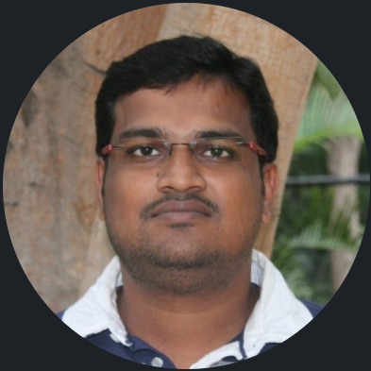
Balaji balasubramanian
About Me
Principal Architect
12+ Experience (.net)
6+ Exp in Sitecore
Sitecore versions – 6.5,7.2,8.2,9.2,10.1(latest)

Slide 3

Survey
About your Sitecore experience
https://www.menti.com/32xn361u14
Or
Go to www.menti.com and use the code 1146 6400
Or
Scan the QR Code

Slide 4
Agenda
Experience Editor, Content Editor & Playing with components
Overview
Layout
Renderings
Placeholders
Shared Vs Final Layout
Publishing Content
Exploring Experience Editor
Exploring Content Editor
Making the component Available in Experience Editor
Adding & Changing the component in Experience editor & Content Editor
Adding & Modifying the content in Experience editor & Content Editor
Publishing the content
Package designer

Slide 5
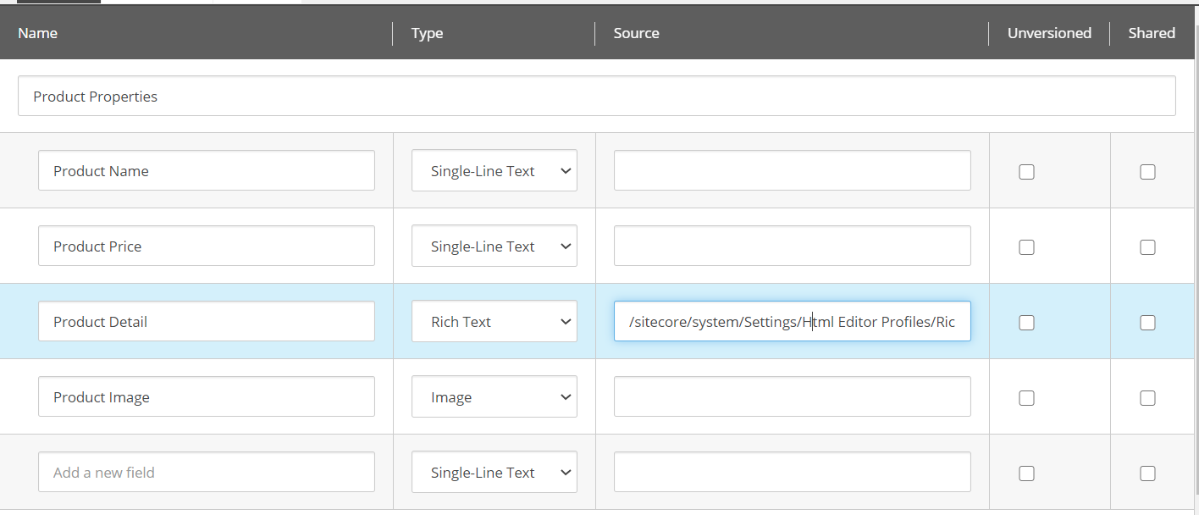
Template
Field Types

Slide 6
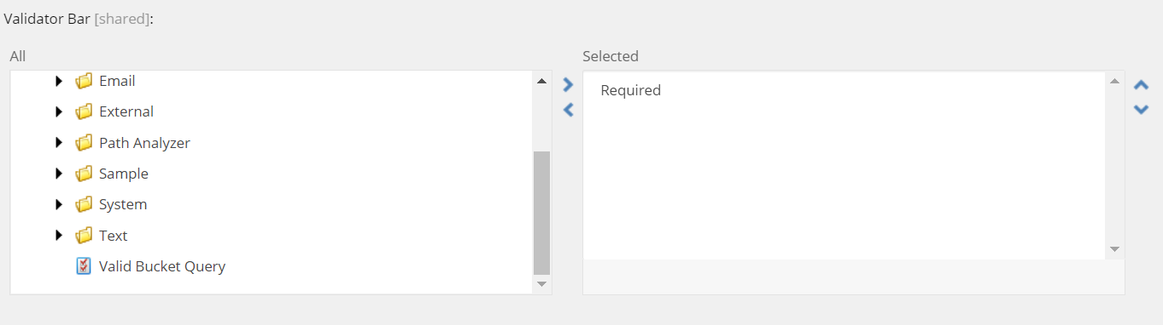
Validation bar
Configuration & Action – both content authoring & experience authoring

Slide 7
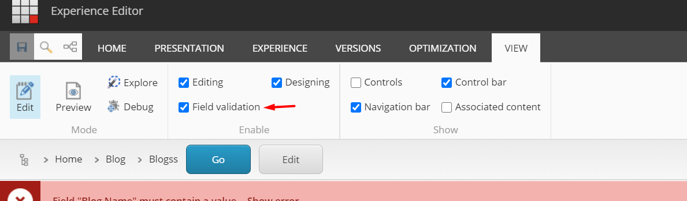
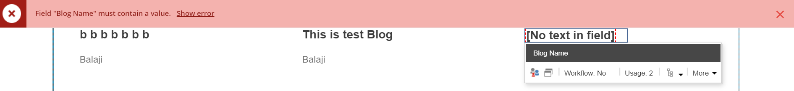
Validation bar
Configuration & Action

Slide 8
Thank you

